Slide 1
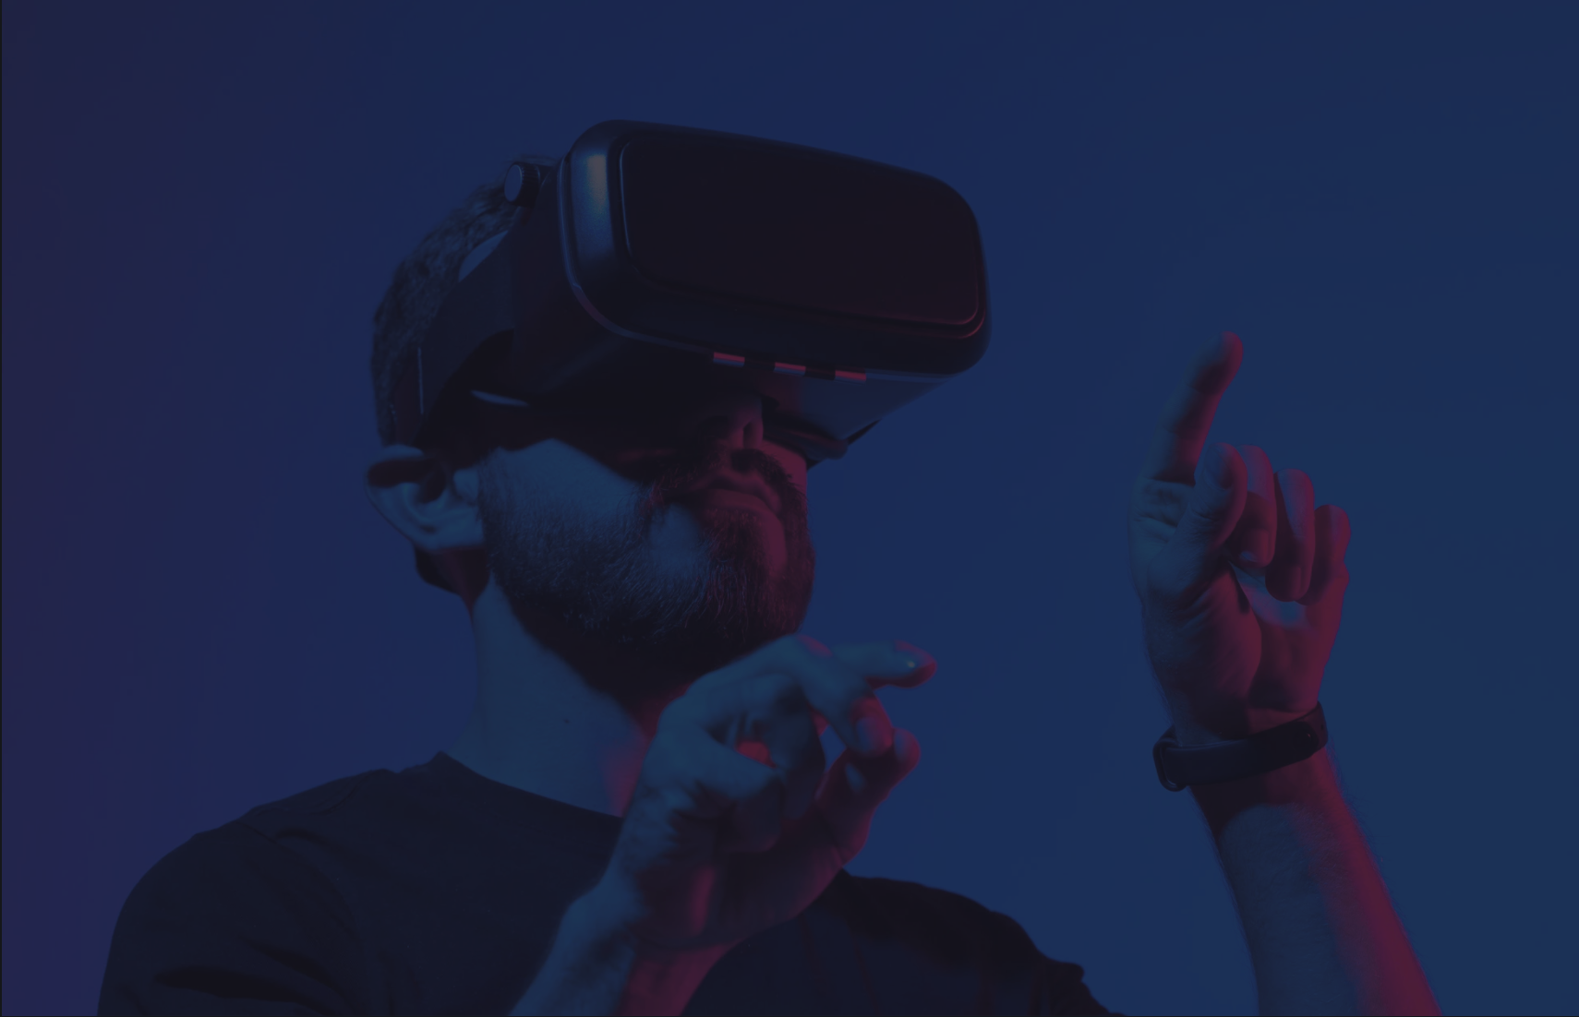



AI Virtual Painter
SUBMITTED TO :
Dr Geeta Kasana
SUBMITTED BY
Devansh Gupta
102103028
3CO1

Slide 2
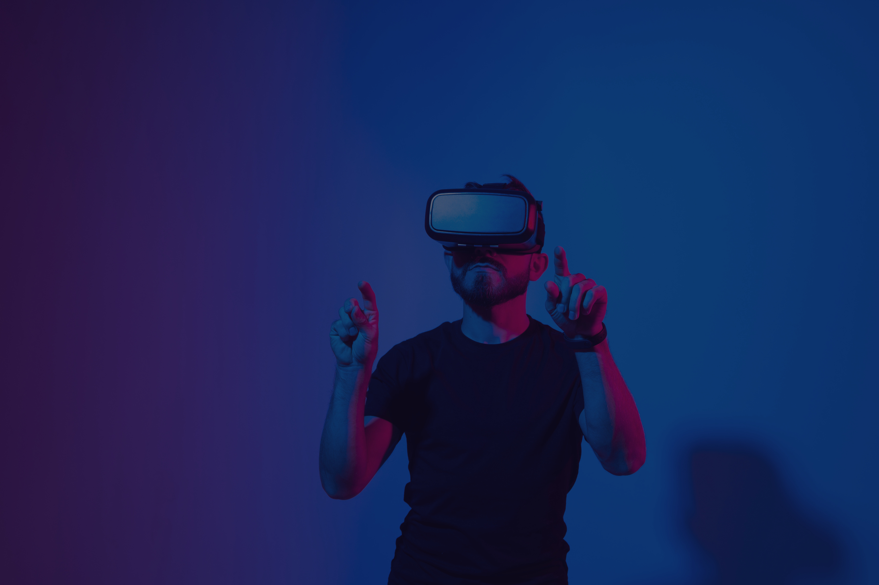
Project Objectives
Develop an AI Virtual Painter: Create an interactive system that tracks hand movements to draw on a virtual canvas.
Real-time Hand Tracking: Utilize computer vision techniques to detect and track hand landmarks in real-time.
Dynamic Drawing Interface: Enable users to draw with different colors using hand gestures.
User-friendly Controls: Implement intuitive keyboard controls to change colors, toggle drawing, and use an eraser.
Optimize Performance: Ensure smooth and real-time processing to enhance user experience and drawing accuracy.

Slide 3
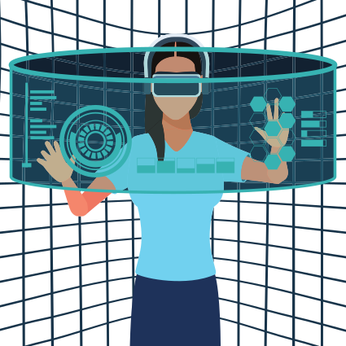
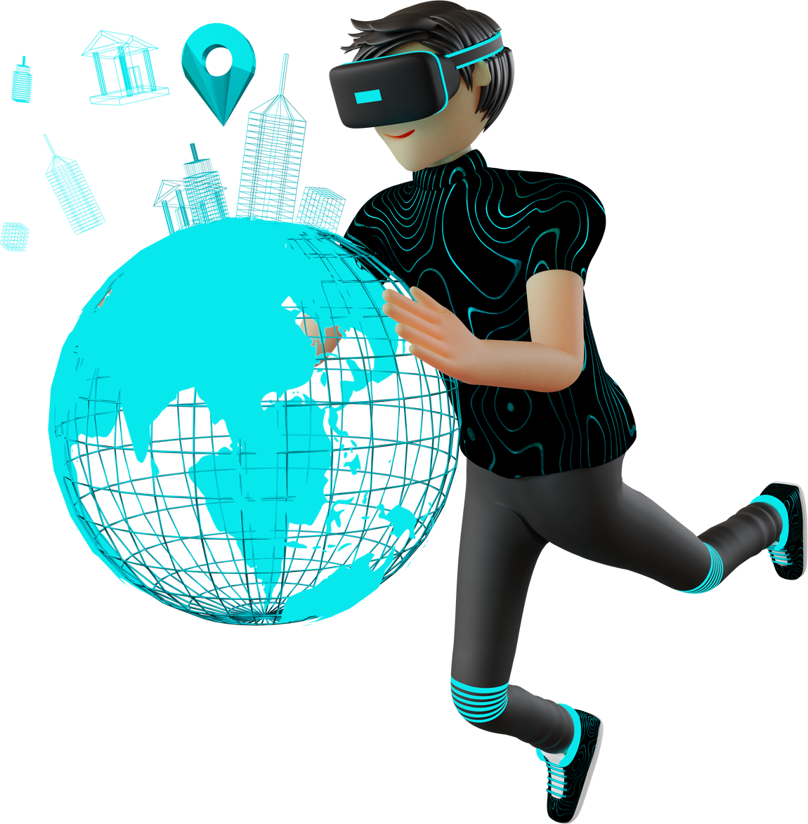
Methodology
Dynamic Drawing Mechanism: Implement a dynamic drawing mechanism that adjusts brush thickness and color based on user input.
Computer Vision with OpenCV and MediaPipe: Utilize OpenCV for video processing and MediaPipe's hand tracking solution to detect hand landmarks.
Hand Gesture Recognition: Identify specific hand gestures, such as pinching, to initiate and control drawing actions.

Slide 4

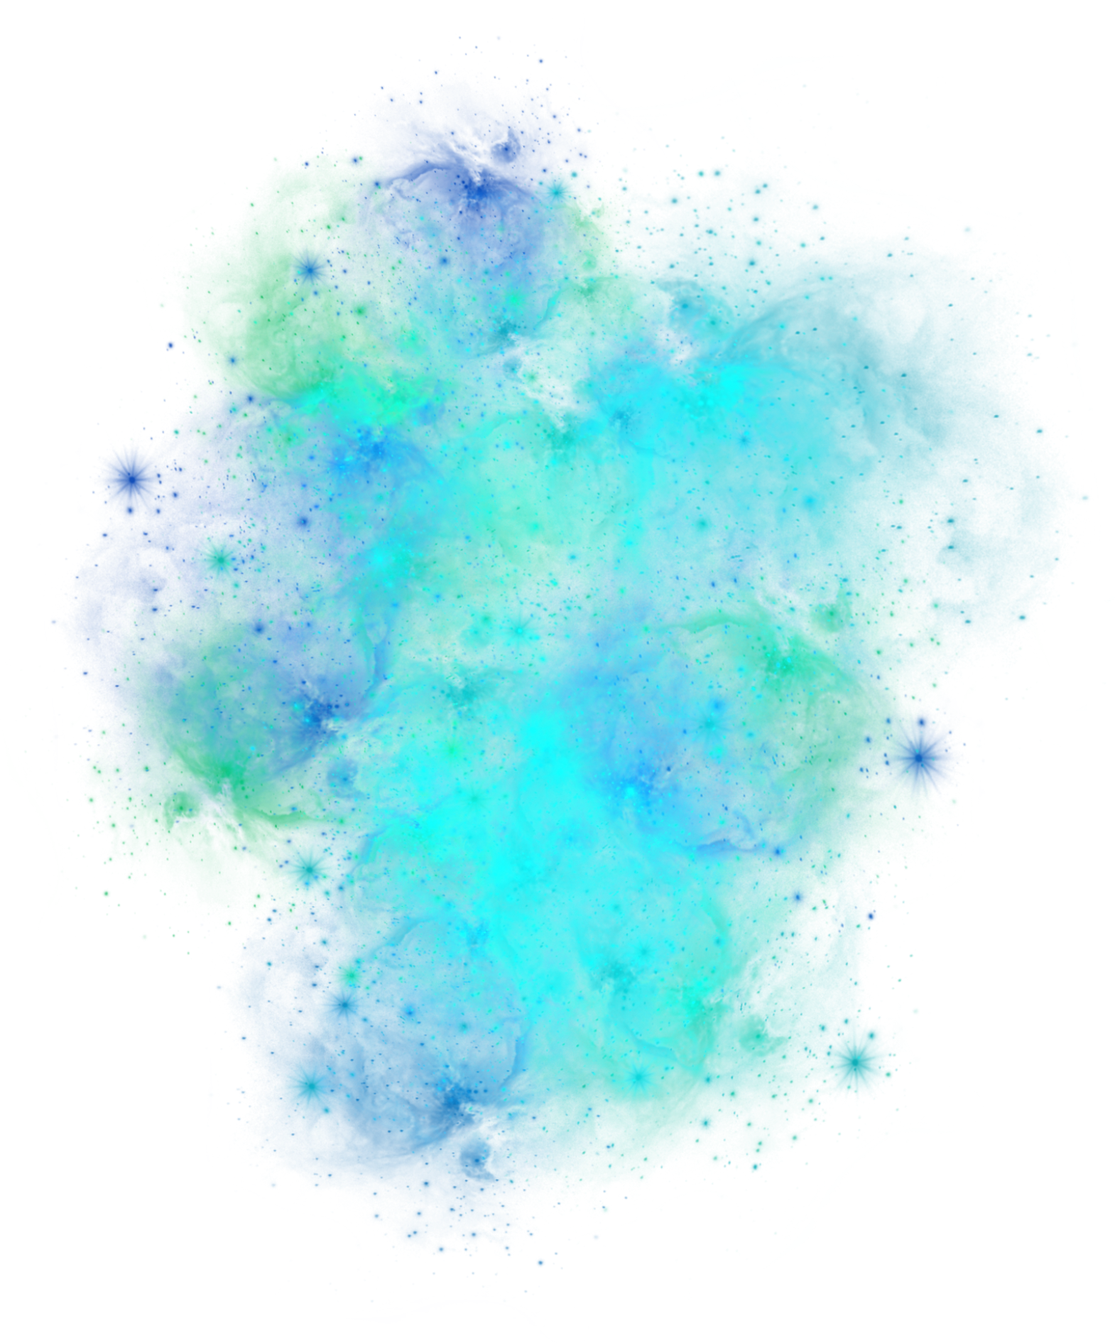
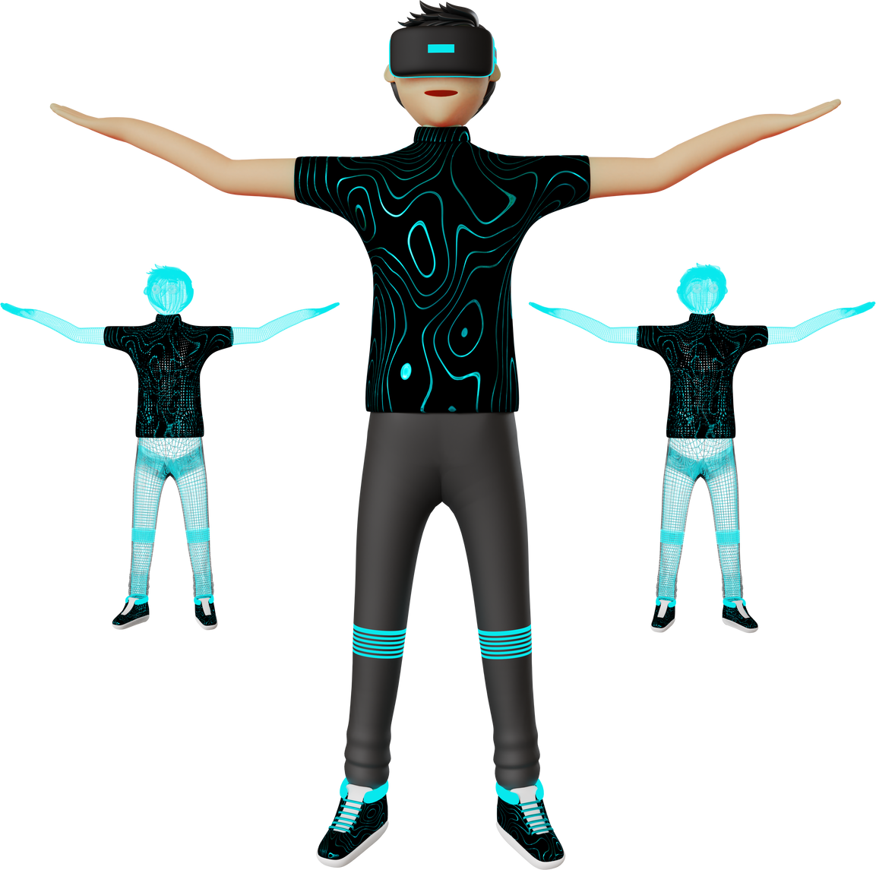
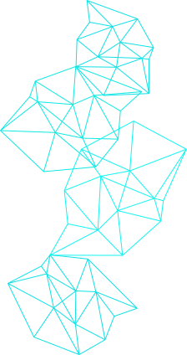
Implementation
Video Capture and Hand Tracking: Initialize the webcam and MediaPipe hands model. Capture and process video frames to detect hand landmarks.
Gesture-based Drawing: Identify the position of the index finger and thumb to determine drawing actions. Draw lines on the virtual canvas based on hand movements and gestures.

Slide 5
Implementation
Color and Thickness Control: Implement keyboard controls to change drawing colors and use an eraser. Dynamically adjust brush thickness based on user input.
Interactive User Interface: Display the virtual painting and canvas side by side for real-time feedback. Update the virtual canvas and display the drawing on the screen using bitwise operations.
Keyboard Input Handling: Handle keyboard inputs to control the program's behavior, such as exiting the program, changing colors, toggling drawing, and pausing drawing.

Slide 6
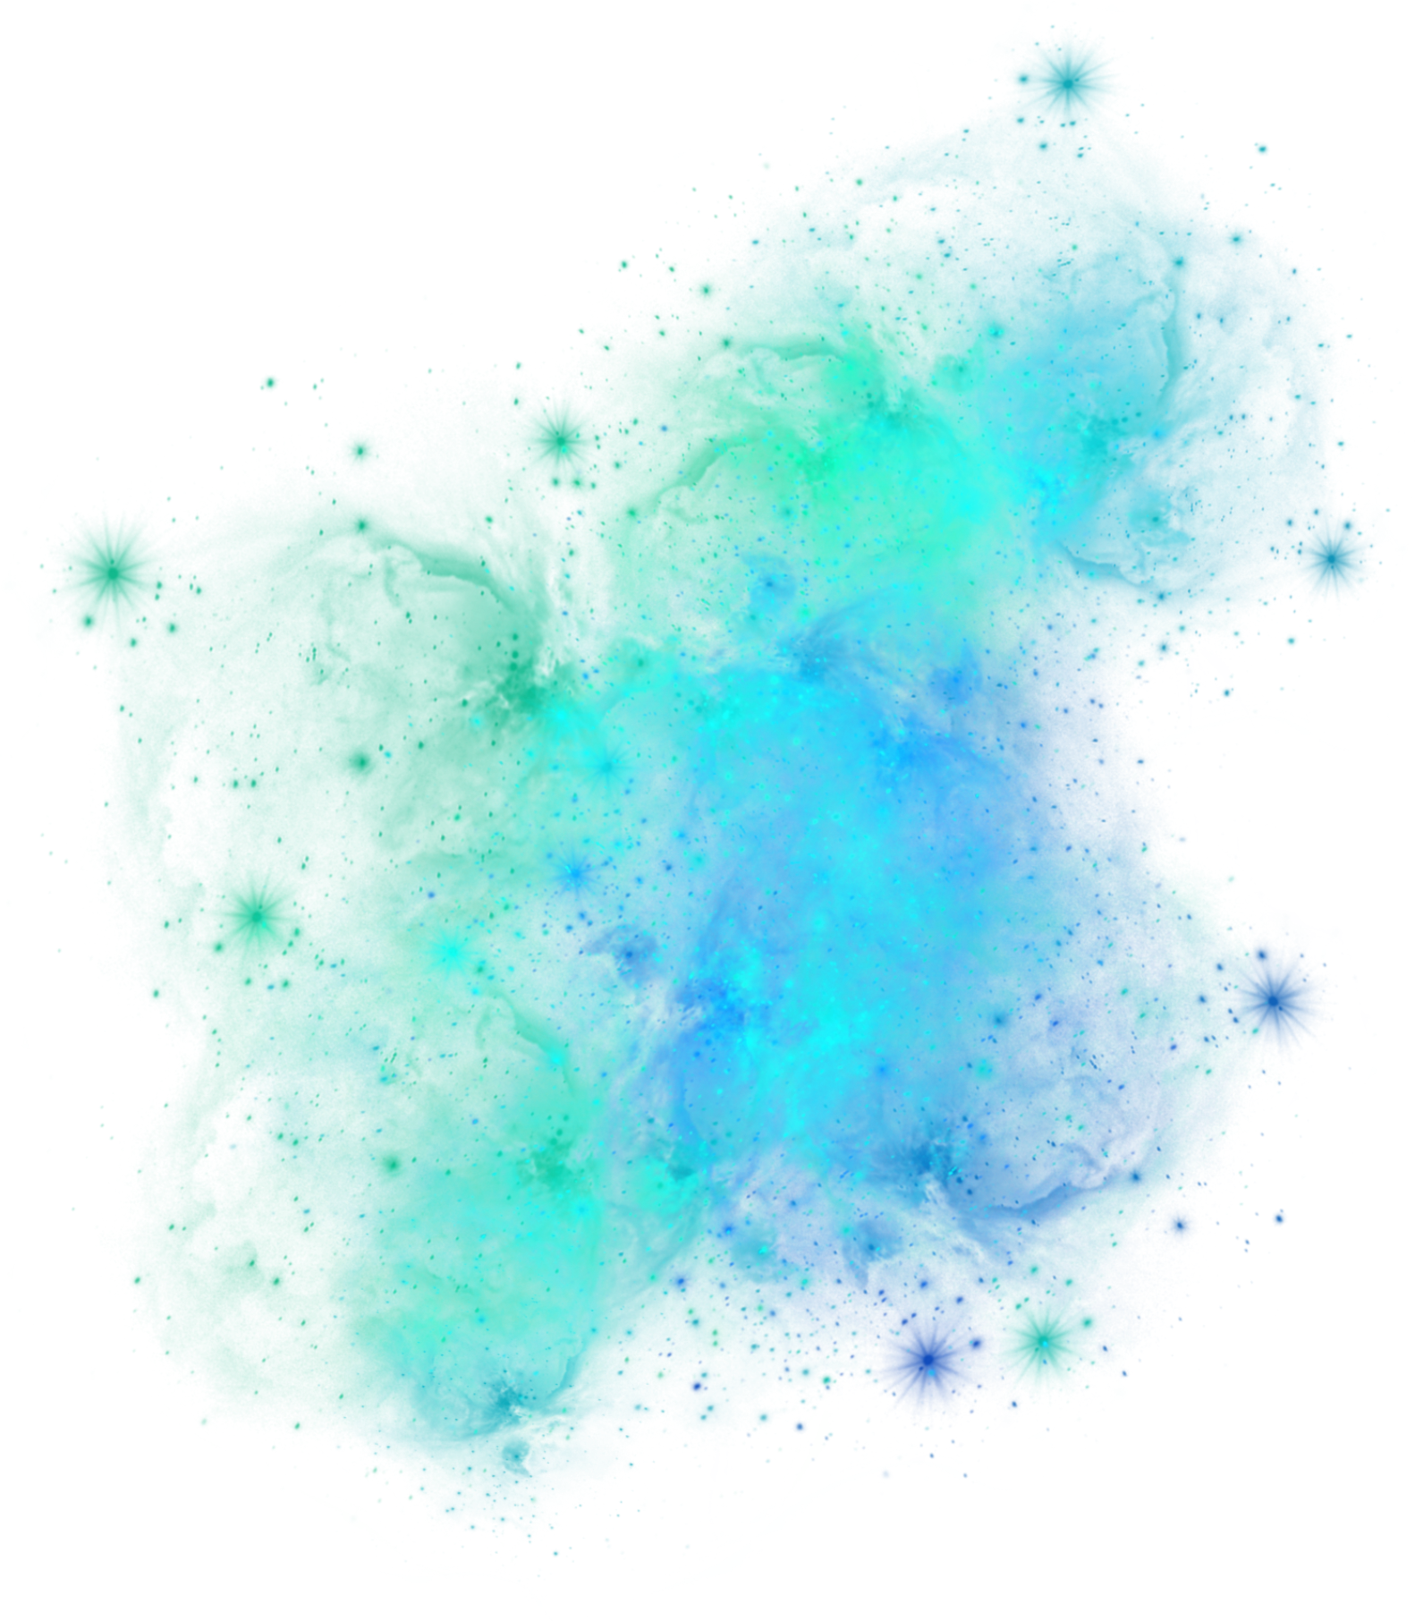

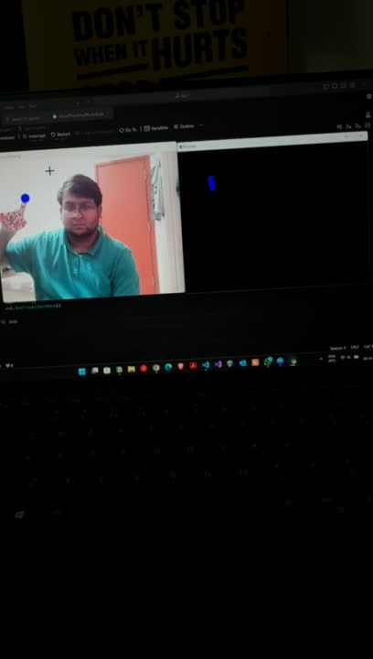
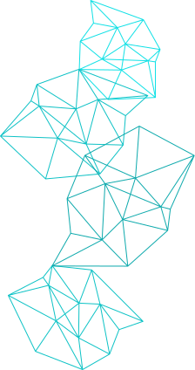
Output

Slide 7
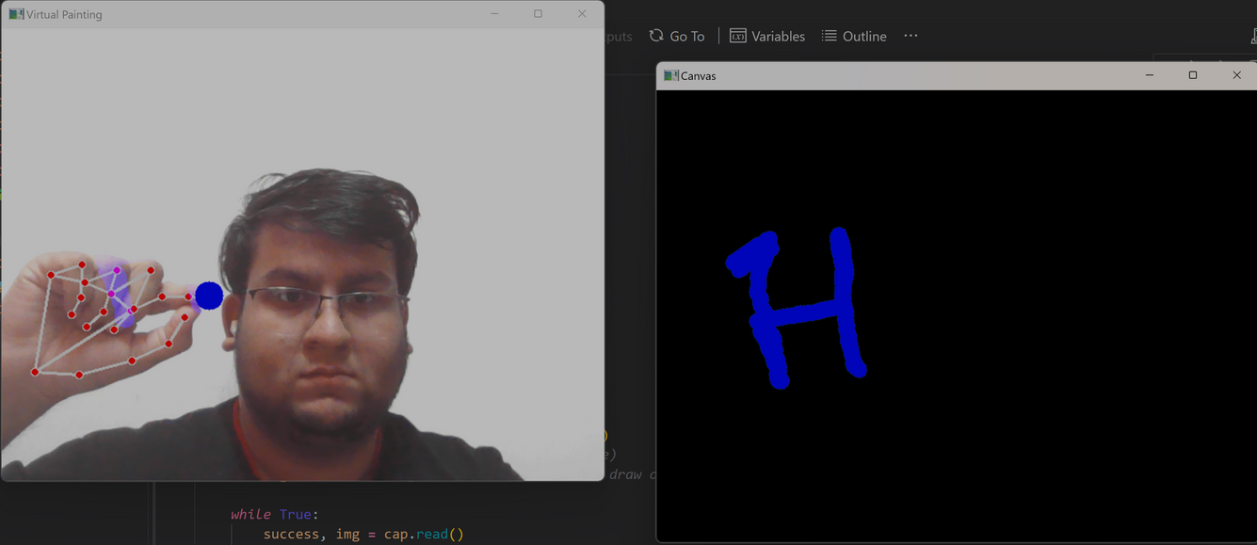
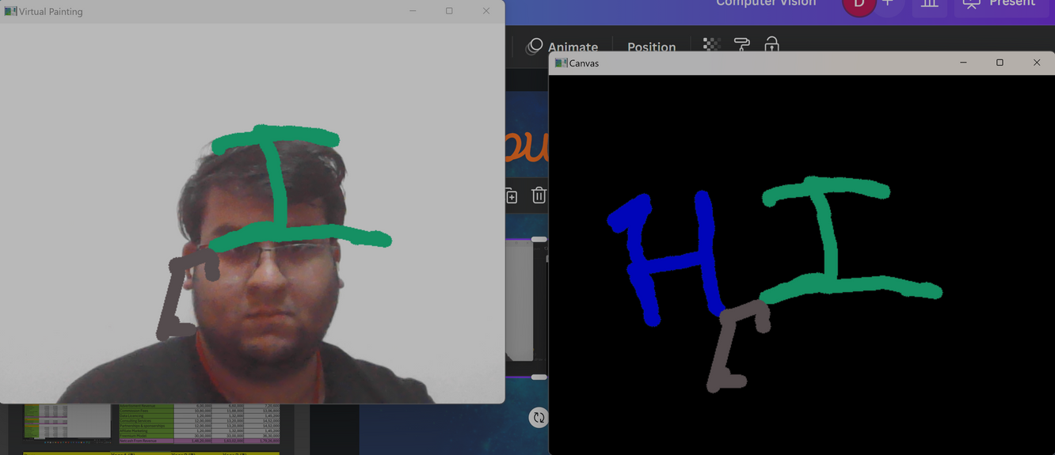
Output

Slide 8
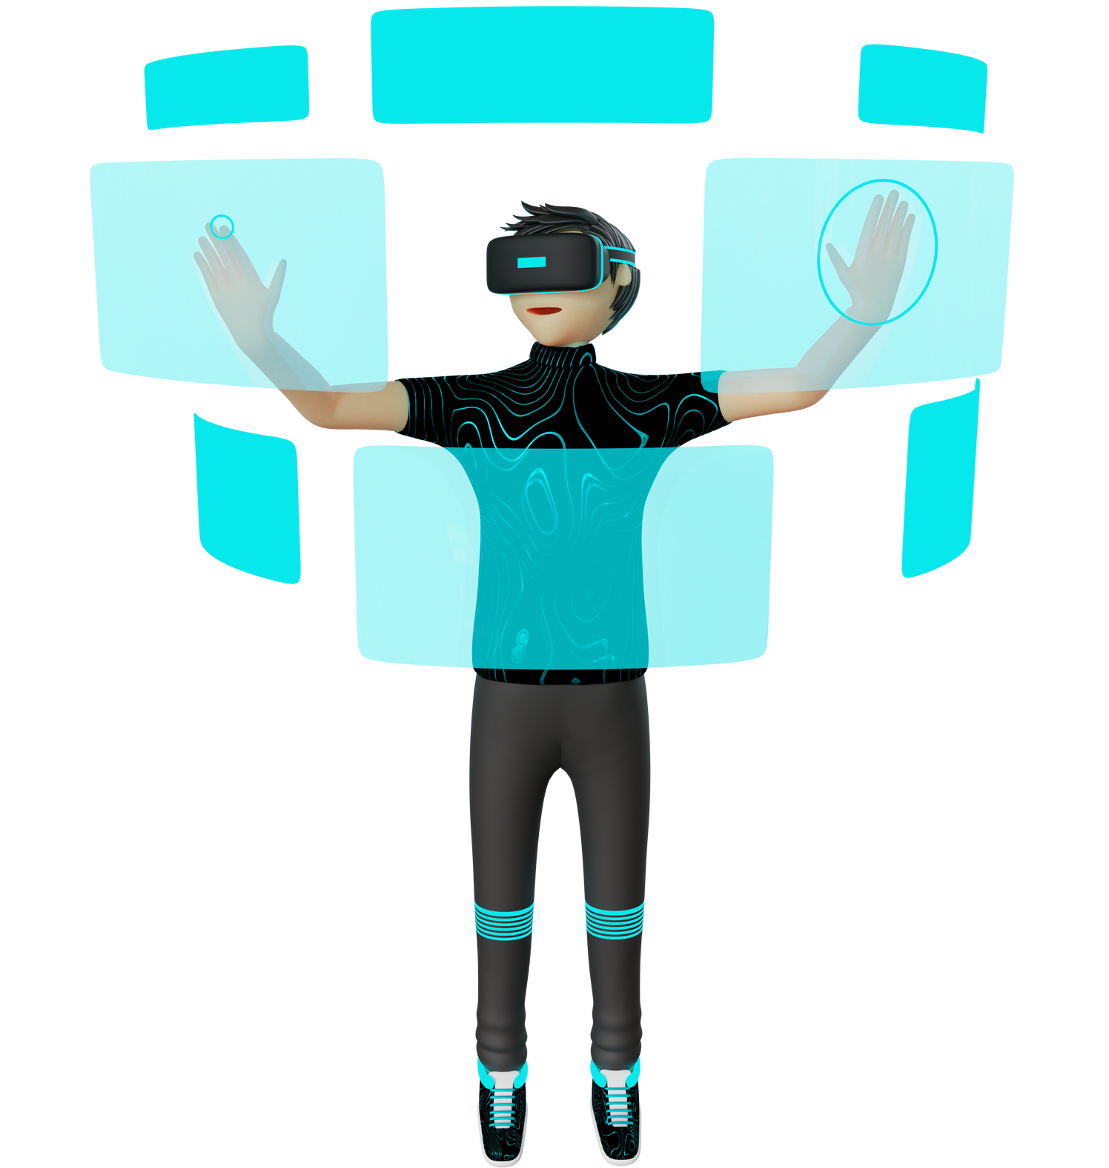
Conclusion
Achieved Objectives: Successfully developed an AI Virtual Painter that tracks hand movements and allows users to draw on a virtual canvas.
Versatility and Customization: Users can dynamically change colors, adjust brush thickness, and use an eraser, enhancing creativity and customization options.
Performance and Efficiency: The implemented solution offers real-time processing with optimized performance, providing a smooth and responsive user experience.

Slide 9
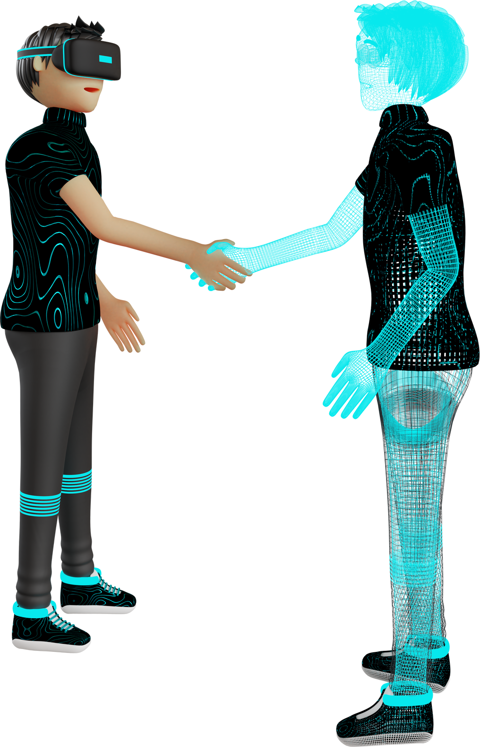

Thank You

